Slide 1
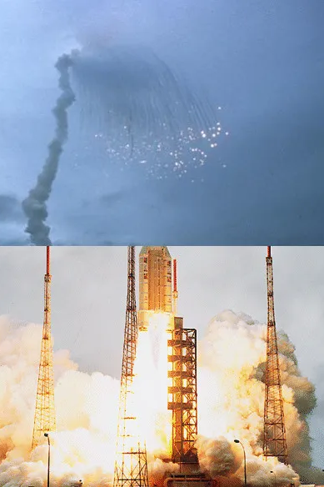

Slide 2
🚀 Ariane 5 Rocket Explosion (1996)
Domain: Aerospace Impact: €370 million loss (rocket destroyed)
What happened:
A 64-bit floating-point value was cast to a 16-bit integer
Reused code from Ariane 4 without validating new flight conditions
No exception handling for overflow
Consequences:
Rocket self-destructed 37 seconds after launch
Mission failed instantly
🧠 QA Lesson:
Reusing “proven” code without re-testing in a new context is dangerous

Slide 3



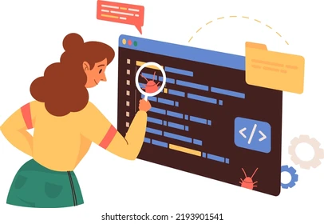
QA Automated Testing Project – CSF - CORP
Multi-Technology Automation Framework
Playwright · Selenium Python · Robot Framework · Jenkins · JIRA XRAY
Application under test: Saucedemo.com
Technologies: Playwright (JS), Selenium (Python), Robot Framework
CI/CD: Jenkins
Test management: JIRA XRAY
The Testers:
Saddem Yousfi – Asma Zakraoui – Houssem Slimi – Marwa Harhouri – Amira Zaidi

Slide 4
Project Overview
Project Objective
- Practice test automation on a real web application
- Design a structured and maintainable automation framework
- Automate critical business flows of Saucedemo
- Integrate test execution with CI/CD and test management tools
Application tested:
- E-commerce demo application (login, catalog, cart, checkout)

Slide 5
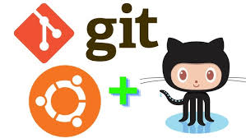
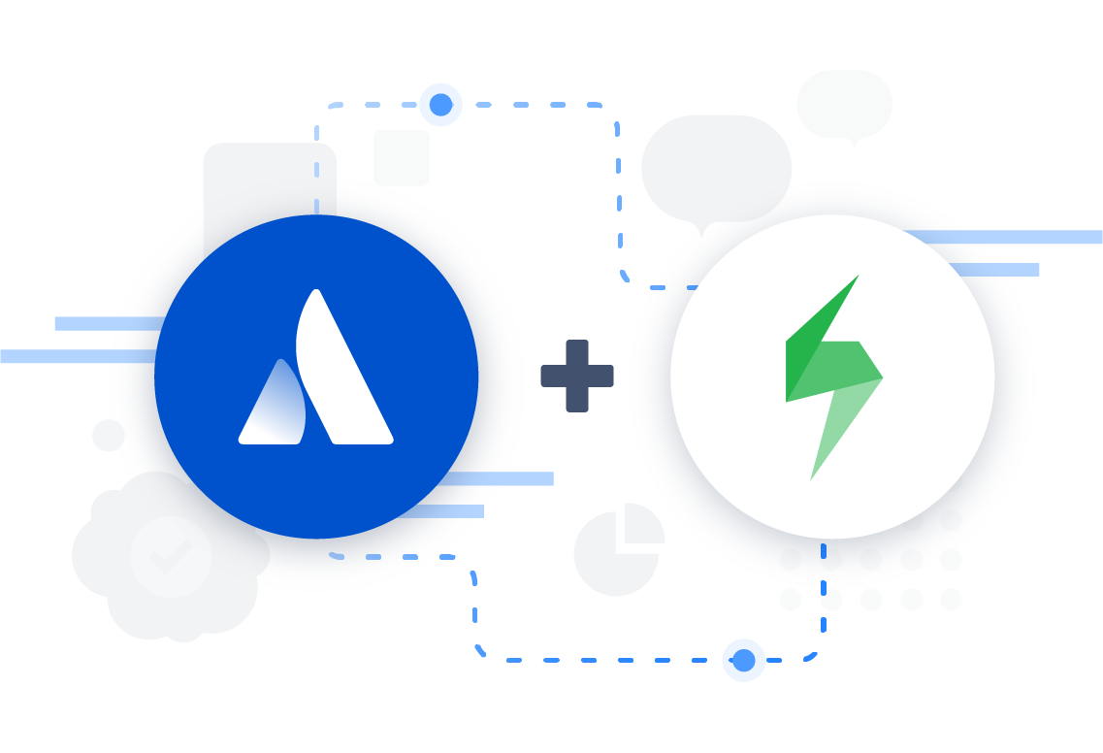

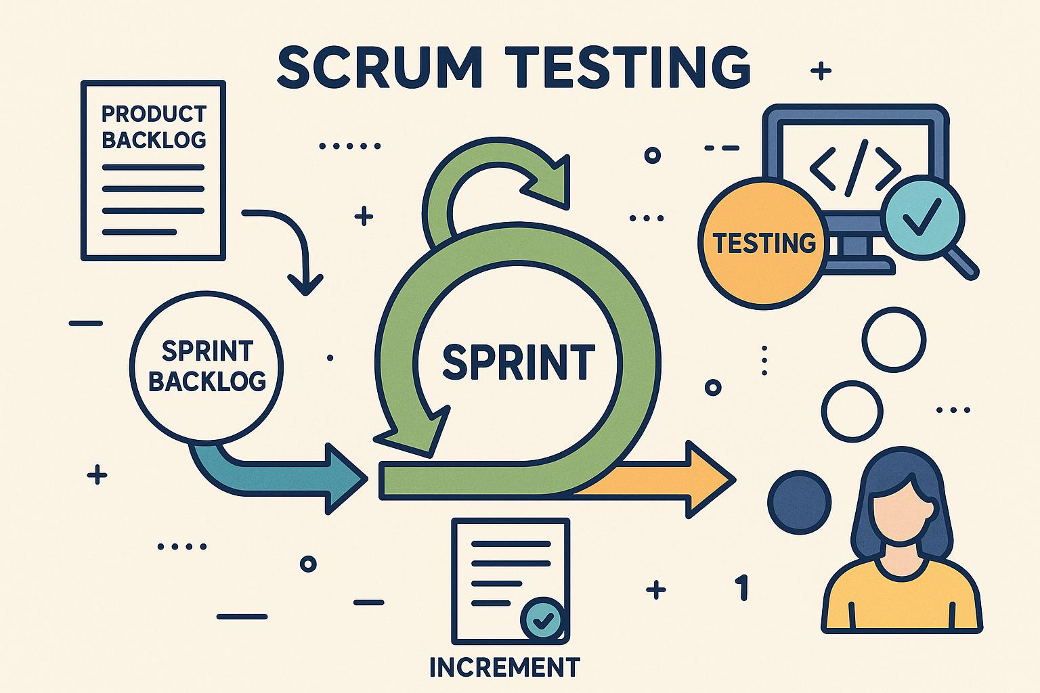
Project Organization & Methodology
Organization & Collaboration
- Individual Git repository per candidate
- One consolidated group repository
- One automated test per candidate
- Total of 5 automated tests in group repository
Methodology:
- SCRUM-inspired organization
- Version control with Git
- CI/CD with Jenkins
- Test traceability with JIRA XRAY

Slide 6
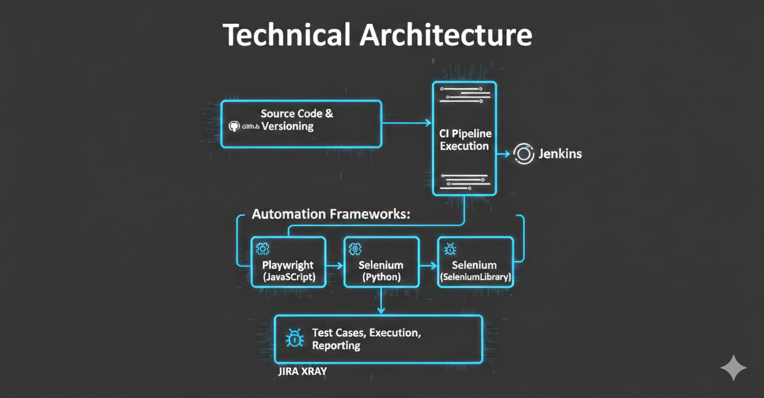
Global Architecture
Technical Architecture
- GitHub → Source code & versioning
- Jenkins → CI pipeline execution
- Automation frameworks:
• Playwright (JavaScript)
• Selenium (Python)
• Robot Framework (SeleniumLibrary)
- JIRA XRAY → Test cases, execution, reporting

Slide 7

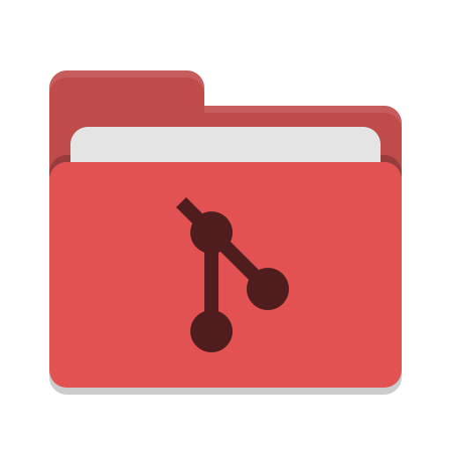
Project Structure
Repository Structure
automation-project-saucedemo/
├─ playwright_tests/
├─ selenium_tests/
├─ robot_tests/
├─ jenkins/
├─ reports/
├─ requirements.txt
├─ package.json
├─ Jenkinsfile
└─ README.md
- Clear separation by technology/testing tool
- Scalable and organized structure

Slide 8
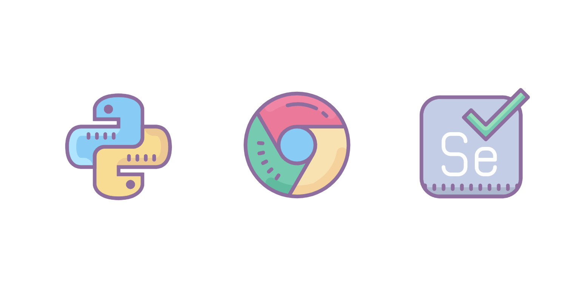
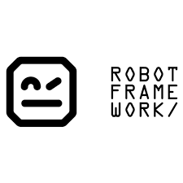
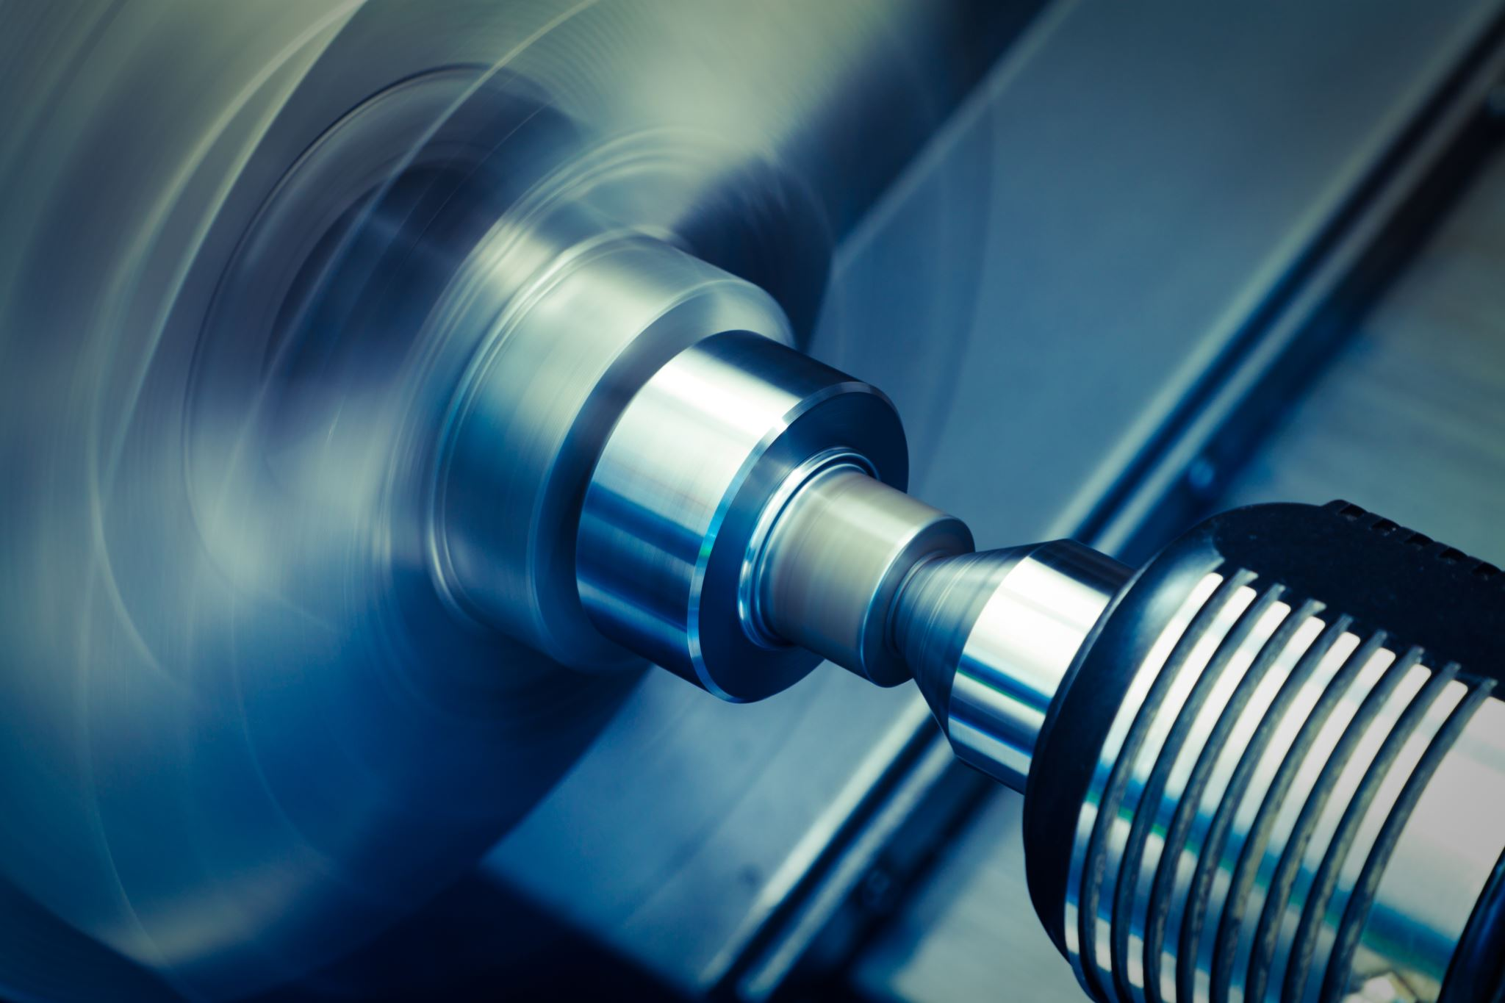


Tools & Technologies
Technology Stack
- JavaScript + Playwright → Modern E2E testing
- Python + Selenium → Browser automation
- Robot Framework → Keyword-driven testing
- Jenkins → Continuous Integration
- JIRA XRAY → Test management & dashboards
Tool choices based on:
- Industry usage (Modern and up2date)
- Complementary strengths
- Learning diverse and different tools

Slide 9
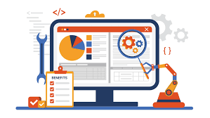
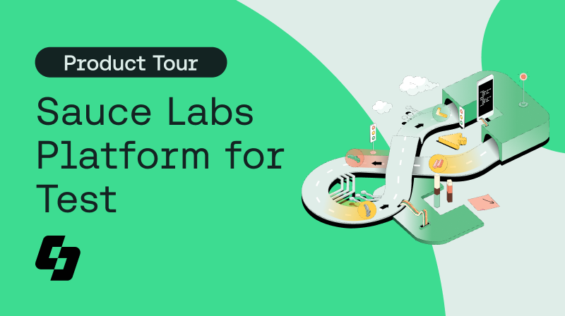
Automated Tests Overview
Test Coverage Summary
ID Technology Test Objective
CCS-1 Playwright Product filtering & sorting
CCS-2 Playwright Complete checkout process
CCS-3 Selenium Python Login error handling
CCS-4 Selenium Python Product catalog validation
CCS-5 Robot Framework Burger menu navigation

Slide 10

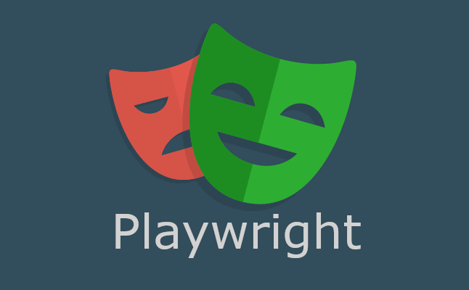
Playwright Test 1
Product Filtering & Sorting
Objective:
- Validate product sorting functionality
Key steps:
- Login using beforeAll
- Verify default filter
- Sort by price (low → high)
- Sort by price (high → low)
- Assertions on product order
- Screenshot capture
Technical focus:
- Playwright hooks
- Dropdown handling
- Robust assertions

Slide 11
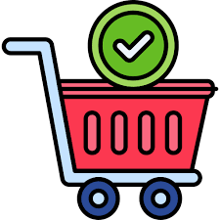
Playwright Test 2
Complete Checkout Process
Objective:
- Validate full purchase workflow
Steps:
- Login
- Add product to cart
- Checkout process
- Form completion
- Order confirmation
Technical focus:
- Test context
- Form handling
- End-to-end flow validation

Slide 12
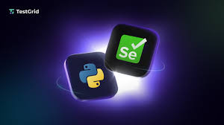

Selenium Python Test 1
Login Error Handling
Objective:
- Validate error messages for invalid login scenarios
Scenarios tested:
- Invalid credentials
- Missing username
- Missing password
- Error message close button
Technical focus:
- Dynamic error elements
- Assertions on messages

Slide 13

Selenium Python Test 2
Product Navigation & Verification
Objective:
- Validate catalog integrity and navigation
Key validations:
- Product presence
- Images visibility
- Add-to-cart buttons
- Product details page
- Total product count
Technical focus:
- Loops for verification
- Page navigation handling

Slide 14
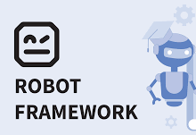
Robot Framework Test
Burger Menu Navigation
Objective:
- Validate side menu behavior
Steps:
- Login
- Open burger menu
- Validate menu items
- Navigate to About (new tab)
- Reset app state
- Logout
Technical focus:
- Keywords
- Variables files
- Window handling

Slide 15
JIRA XRAY Integration
Test Management
XRAY project: CORP-CSF-SAUCEDEMO-TEST
5 automated test cases created
Manual result logging with:
- PASS / FAIL
- Screenshots
- Comments
Dashboard widgets:
- Test summary
- Execution progress
- Execution history
- Technology distribution

Slide 16

Jenkins CI Pipeline
CI/CD Pipeline
Pipeline stages:
- Code checkout
- Dependency installation (Python & Node.js)
- Playwright test execution
- Selenium test execution
- Robot Framework execution
- Report publication
Artifacts:
- HTML reports
- Screenshots

Slide 17
Results & Reporting
Execution Results
- All 5 tests executed via Jenkins
- Reports generated successfully
- Results synchronized in XRAY
- Pipeline stability validated
(Include Jenkins & XRAY screenshots)

Slide 18
Challenges & Solutions
Challenges Encountered
- Dynamic elements → Stable selectors
- Test flakiness → Wait strategies
- Multi-tech pipeline → Execution order control
Solutions:
- Explicit waits
- Modular test design
- Clean CI pipeline structure

Slide 19
Improvements & Next Steps
Future Enhancements
- Parallel execution
- CI integration with XRAY API
- Cross-browser testing
- Data-driven testing
- Dockerized execution

Slide 20

Conclusion
Project Summary
- Designed a multi-technology automation framework
- Implemented 5 robust automated tests
- Integrated CI/CD and test management
- Applied industry best practices
This project demonstrates practical skills in:
- Test automation
- CI/CD
- Test management
- Framework design

Slide 21


